Slide 1
HIGH-SPEED REGULAR EXPRESSION MATCHING ENGINE USING MULTI-CHARACTER NFA
Author: Norio Yamagaki , Reetinder Sidhu, Satoshi Kamiya
Publisher/Conference: Field Programmable Logic and Applications, 2008. FPL 2008. International Conference on
Presenter: Cheng-Feng Ke
Date: 2017/08/09
Department of Computer Science and Information Engineering
National Cheng Kung University, Taiwan R.O.C.
Notes:
1

Slide 2
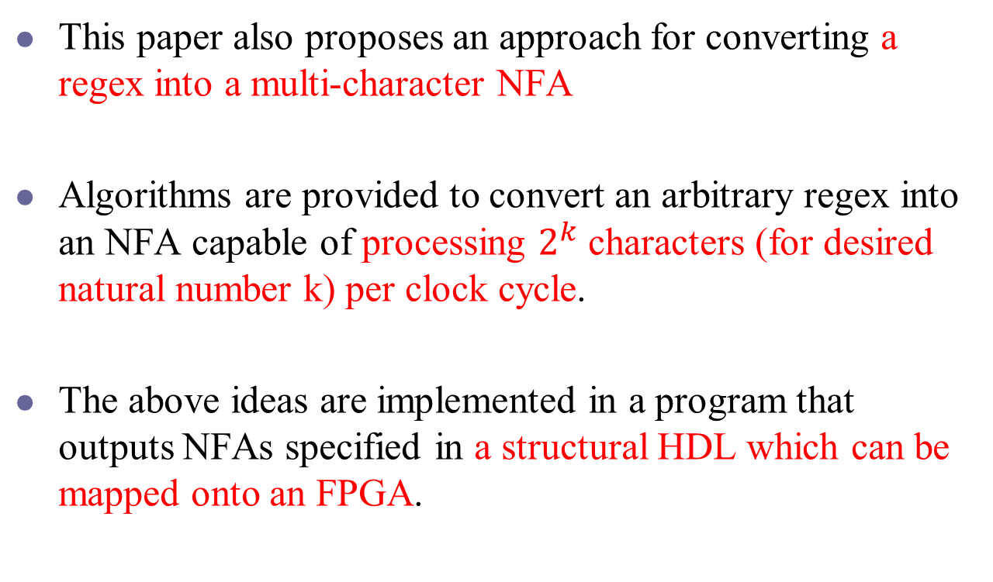
INTRODUCTION
This paper also proposes an approach for converting a regex into a multi-character NFA
Algorithms are provided to convert an arbitrary regex into an NFA capable of processing $2^{k}$ characters (for desired natural number k) per clock cycle.
The above ideas are implemented in a program that outputs NFAs specified in a structural HDL which can be mapped onto an FPGA.
Notes:
提出一個方法將 regex 轉換成可以處理多個 char 的 NFA。
他的方法可以設定一個 cycle 能處理 2^k 個 char，k 可以自己設定。
實作結果是呈現在 FPGA 上。

Slide 3
INTRODUCTION
Regex
a(bc)*(d|e)
Syntax Tree
abc˙*˙de| ˙
1-character NFA
graphs
Multi-character NFA
graphs
Verilog
HDL
Regular Expression to Verilog NFA translator (REVN)

Slide 4
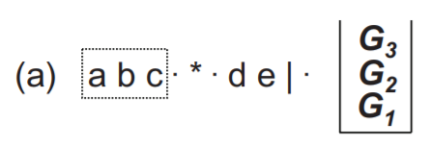
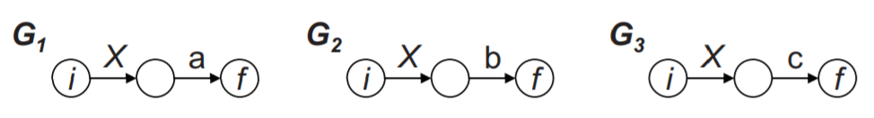
Syntax Tree to 1-character NFA
Regex: a(bc)*(d|e)
Syntax Tree: abc˙*˙de| ˙

Slide 5
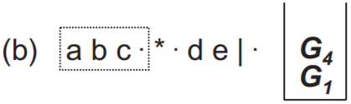
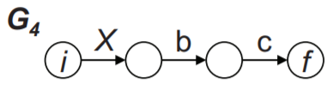
Syntax Tree to 1-character NFA
Regex: a(bc)*(d|e)
Syntax Tree: abc˙*˙de| ˙

Slide 6
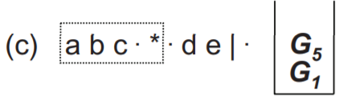
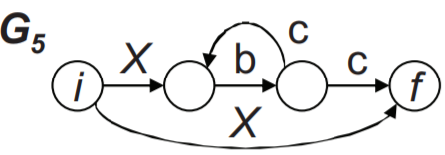
Syntax Tree to 1-character NFA
Regex: a(bc)*(d|e)
Syntax Tree: abc˙*˙de| ˙

Slide 7
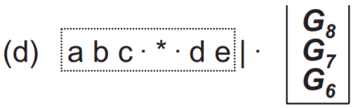
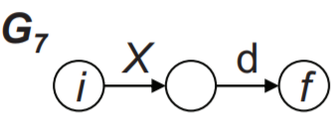
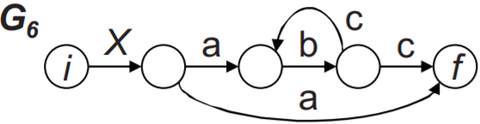
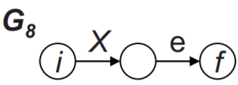
Syntax Tree to 1-character NFA
Regex: a(bc)*(d|e)
Syntax Tree: abc˙*˙de| ˙

Slide 8
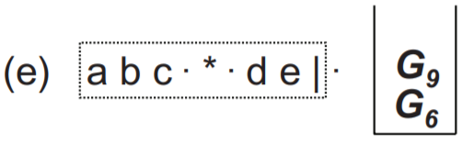
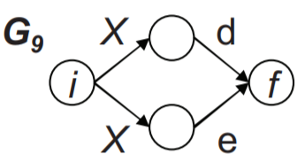
Syntax Tree to 1-character NFA
Regex: a(bc)*(d|e)
Syntax Tree: abc˙*˙de| ˙

Slide 9
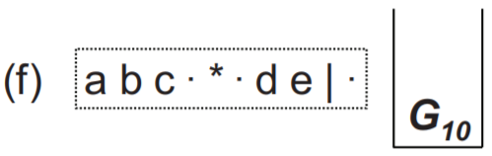
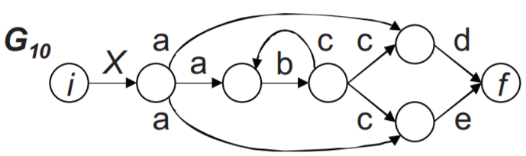
Syntax Tree to 1-character NFA
Regex: a(bc)*(d|e)
Syntax Tree: abc˙*˙de| ˙

Slide 10
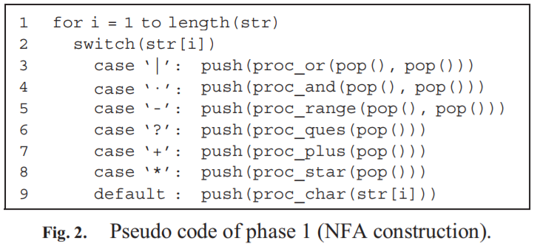
Syntax Tree to 1-character NFA

Slide 11
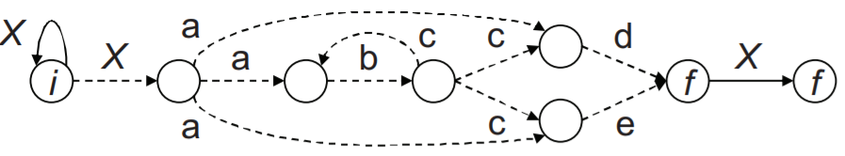
1-character NFA to 2-character NFA

Slide 12
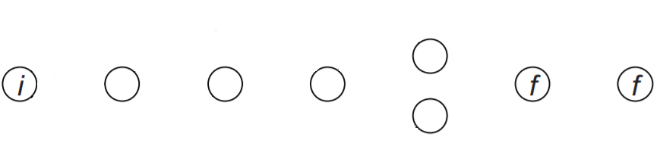
1-character NFA to 2-character NFA

Slide 13
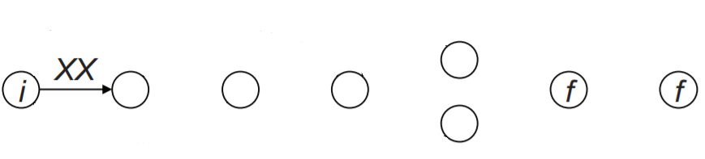
1-character NFA to 2-character NFA

Slide 14
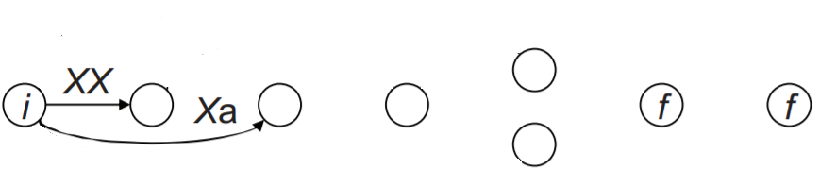
1-character NFA to 2-character NFA

Slide 15
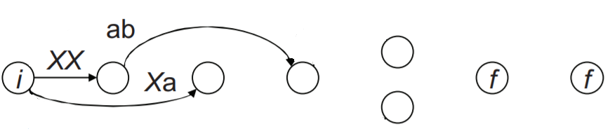
1-character NFA to 2-character NFA

Slide 16
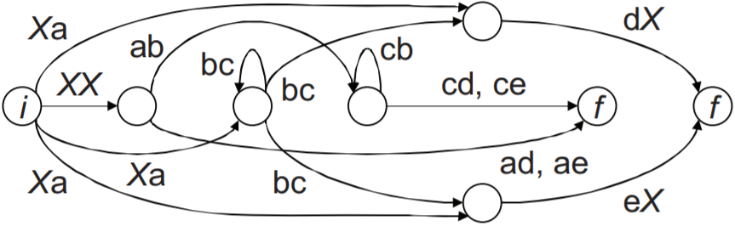
1-character NFA to 2-character NFA
1-character NFA
2-character NFA

Slide 17
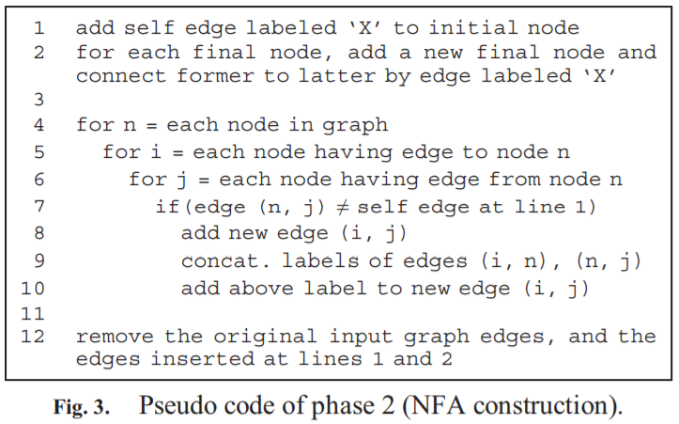
1-character NFA to 2-character NFA

Slide 18
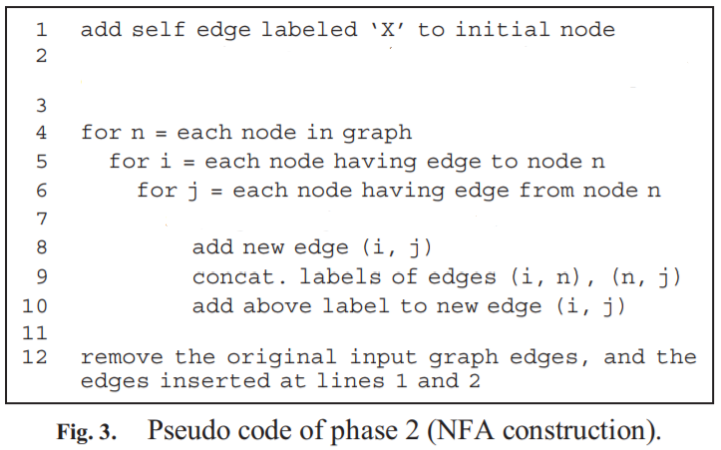
Match mode and Non match mode
If only information about whether the input string matches a regex or not is required (we call this “non-match mode”), following simplifications can be made;
add self edge labeled ‘X’ to the final node
if( edge (i, n) self edge at line 2 and edge (n, j) self edge at line 1 )

Slide 19
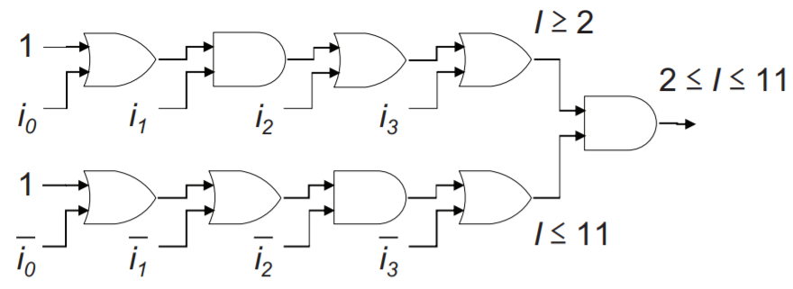
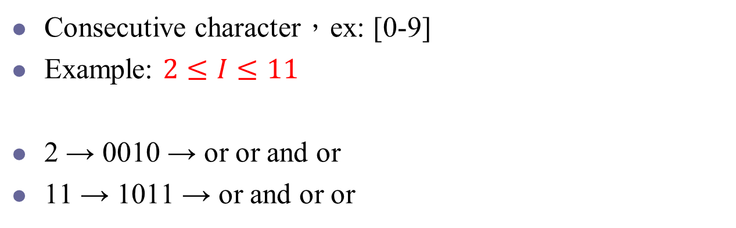
Range Matching
Consecutive character，ex: [0-9]
Example: $2≤I≤11$
2 → 0010 → or or and or
11 → 1011 → or and or or

Slide 20
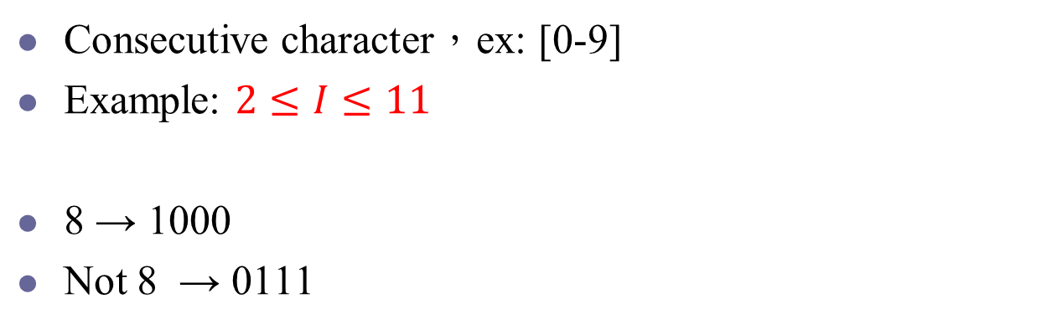
Range Matching
Consecutive character，ex: [0-9]
Example: $2≤I≤11$
8 → 1000
Not 8 → 0111
1
0
0
1
0
0
0
1
1
1
1
1
1
1
1
1
0

Slide 21

Range Matching
Consecutive character，ex: [0-9]
Example: $2≤I≤11$
12 → 1100
Not 12 → 0011
1
0
1
1
0
0
1
1
0
1
1
0
0
1
1
0
0

Slide 22
Performance Evaluation
In this evaluation, to use meaningful regexes, we extract them from Snort 2.4 ruleset.
64 regexes
2,691 regexes which do not include interval quantifiers ({2,4})
128 regexes
Select regexes randomly from the above two regex sets
256 regexes
357 regexes which include interval quantifiers
512 regexes
1024 regexes
2048 regexes

Slide 23
Performance Evaluation
We target Altera Stratix II (EP2S180) FPGA [10] and use Quartus II 7.2 SP1 [11] without any optimization options.
The Adaptive Logic Module (ALM) is the basic building block of supported device families and is designed to maximize performance and resource usage.
Each ALM, composed of two Adaptive Look-Up Tables (ALUT).

Slide 24
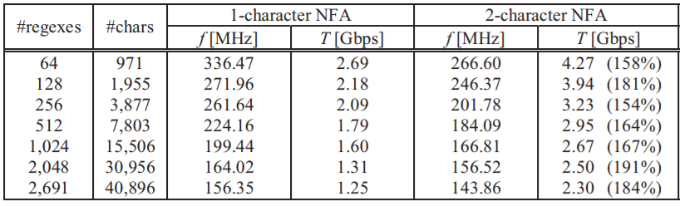
Table 1. Maximum operating frequency, f, and throughput, T, of 2,691 regexes (non-match mode).
\d,\D,\s,\S,\w,\W,\a,\e,\f,\n,\r,\t,\x are counted as one character.
156.35 * 8 bit
= 1250.8
143.86 * 16 bit
= 2301.76
The throughput is calculated by multiplying the number of bits in characters processed every clock cycle by operating frequency.

Slide 25
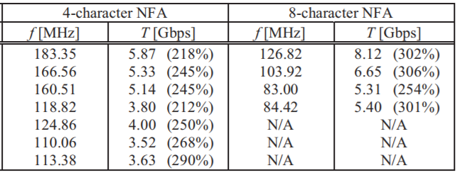
Table 1. Maximum operating frequency, f, and throughput, T, of 2,691 regexes (non-match mode).
very long compilation time

Slide 26
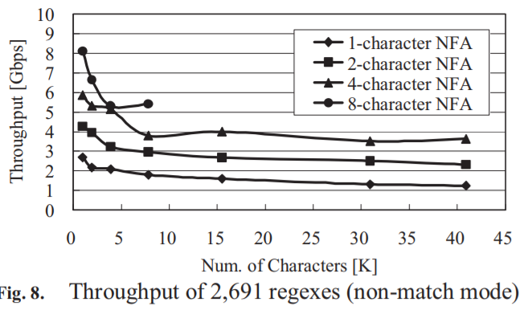
Performance Evaluation

Slide 27
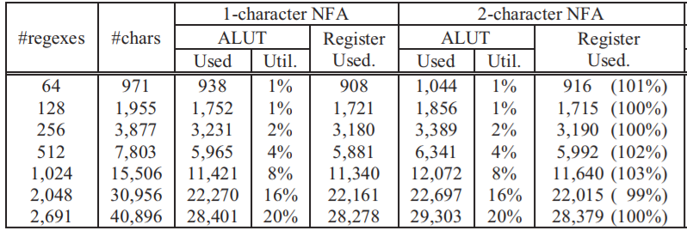
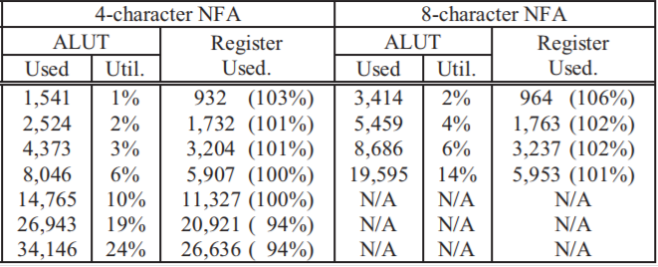
Table 2. Logic usage of 2,691 regexes (non-match mode).

Slide 28
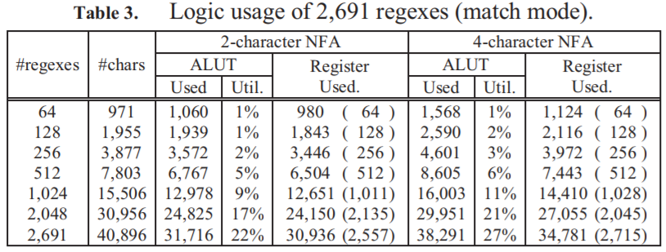
Performance Evaluation

Slide 29
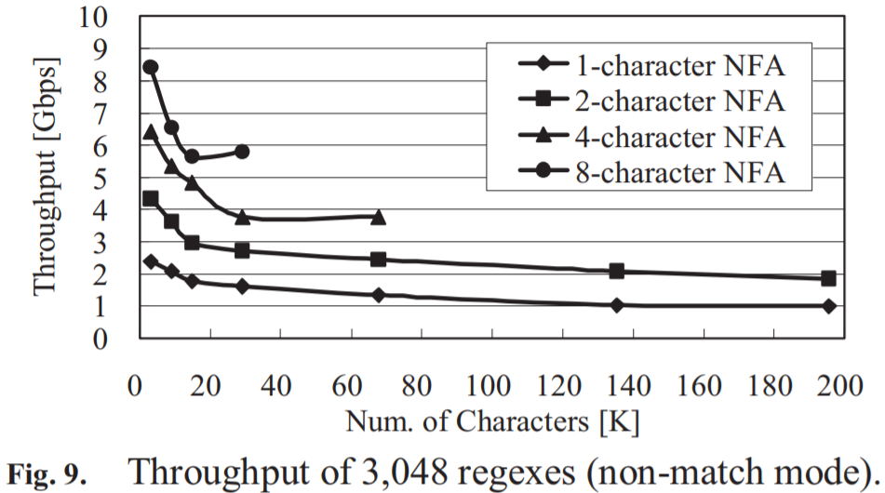
Performance Evaluation
Due to REVN handling of interval quantifiers, this regex set includes more characters than the previous one.

Slide 30
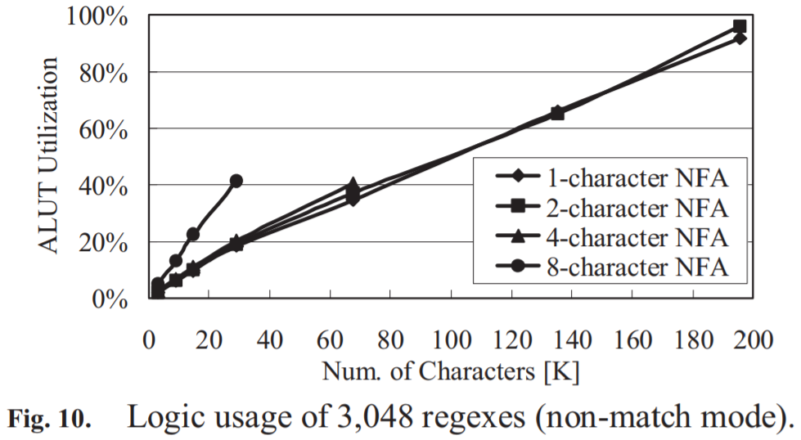
Performance Evaluation
In the case of 195,577 characters, while the logic usage is more than 90% in 2- and 4- character NFAs, the throughput achieved is 1 and 2 Gbps respectively.

Slide 31
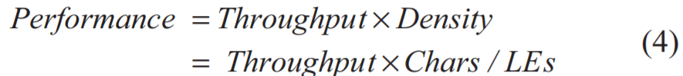
Performance Evaluation
[5] C. R. Clark and D. E. Schimmel, “Scalable Pattern Matching for High Speed Networks,” in Proc. 12th IEEE Symposium on Field-Programmable Custom Computing Machines (FCCM’04), pp.249-257, April 2004.
The number of Logic Elements (LEs) in Stratix II can be obtained as 1.25 times the number of ALUTs.
1-char NFA: 1790 * 7803 / (5965 * 1.25) = 1873.24325
4-char NFA: 3800 * 7803 / (8046 * 1.25) = 2948.18792*
8-char NFA: 5400 * 7803 / (19595 * 1.25) = 1720.28375

